Slide 1
A Systematic Study of Automated Program Repair:
Fixing 55 out of 105 Bugs for $8 Each
Presented by Rabeya Khatun Muna
(40298882)

Slide 2
Overview
Motivation and Problem Statement
Related Work
Introduction to GenProg
GenProg Methodology
Experimental Setup and Benchmark Details
Results and Analysis
Limitations

Slide 3
Motivation & Problem Statement
Software Maintenance Challenge:
50-75% of software costs are spent on maintenance.
Human resources are insufficient to address all bugs.
Automated Repair Tools:
Overview of prior techniques (ClearView, AutoFix-E, AFix)
Genetic Programming (GP):
Inspired by biological evolution
Iterative process of selection, mutation, and crossover
Key Question:
“What fraction of bugs can be repaired automatically?” and “How much does it cost?”

Slide 4
Related Work
Automated Repair Tools:
ClearView: Binary patches for security bugs.
AutoFix-E: Requires contracts (Eiffel).
AFix: Atomicity violations only.
GenProg Advantages:
General-purpose, no annotations, scales to MLOC.

Slide 5
Introducing GenProg
What is GenProg?
An automated program repair tool using genetic programming.
How It Works (Simple Example):
Start with a buggy program.
Apply random modifications (patches) to the code.
Test each variant to see if it fixes the bug.
“Evolve” better fixes until a successful repair is found.
Key Contributions:
Scales to millions of lines of code.
Uses cloud computing for parallel trials and cost measurement.
Provides a systematic evaluation on a large set of real-world defects.

Slide 6
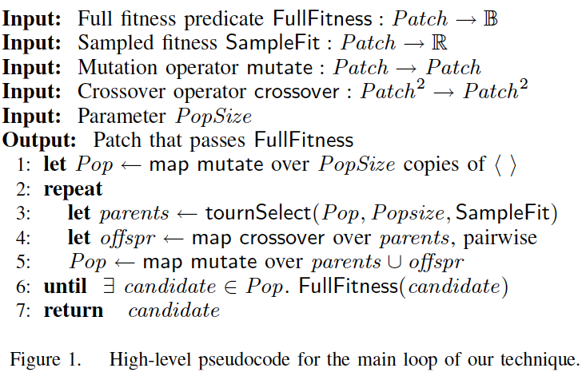
GenProg Methodology
Initialization: Create a population of random patches.
Fault Localization: Focus on code executed by failing tests.
Fix Localization: Source code from in-scope, tested statements.
Mutation Operators: Delete, insert, replace.
Crossover: Combine edits from two parents.
Fitness Evaluation: Weighted test pass rate.

Slide 7
Experimental Setup
Benchmark Overview:
Dataset: 105 defects from 8 open-source C programs.
Code Size: Total of 5.1 million lines of code.
Test Cases: 10,193 tests.
Selection Criteria:
Defects are reproducible bugs taken from version control histories.
Only bugs significant enough to be fixed by human developers are considered.
Execution:
Multiple parallel trials using cloud computing (Amazon EC2).
Parameters: 10 trials per bug, population size of 40, and up to 10 generations.

Slide 8
Results & Analysis
How many defects GenProg repairs and at what cost
What factors determine the success rate
The impact of alternative repair strategies
A comparison between automated and human-written repairs

Slide 9
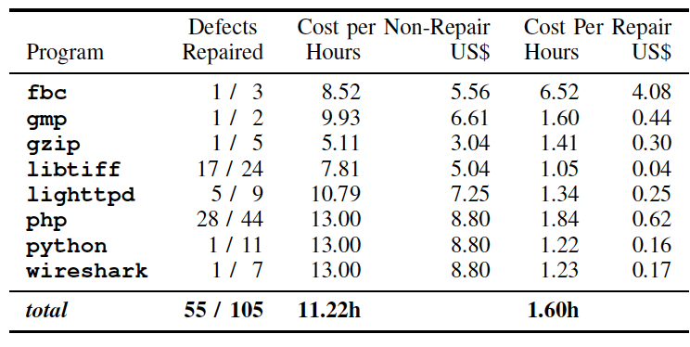
How Many Defects Can GenProg Repair?
GenProg repaired 55 defects (~52% success rate).
Cost & Time:
Average successful repair: 1.6 hours.
Average unsuccessful repair: 11.22 hours.
Total cost for 105 runs: $403 (~$7.32 per successful repair).

Slide 10
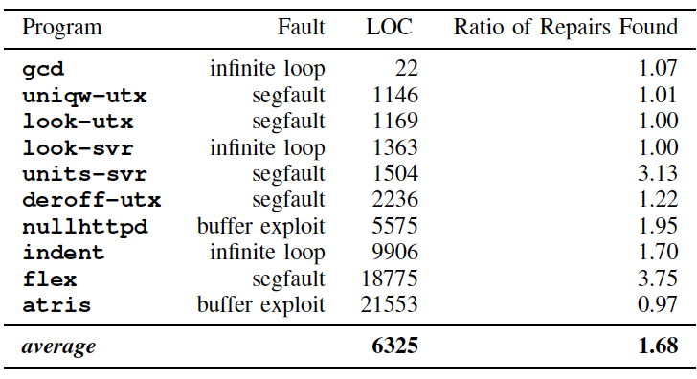
What Determines the Success Rate?
Algorithmic Improvements:
New patch-based representation and genetic operators increased repair rate by 68% compared to the previous method.
External Metrics Analysis:
No strong correlation between repair success and bug severity or human repair time/size.
Slight negative correlation: More files touched in human patches → lower success for GenProg.
Internal Metrics Analysis:
Fault Localization: Larger fault localization space (more possible error locations) tends to decrease repair success.
Fix Localization: Larger fix space can reduce the number of evaluations needed.

Slide 11
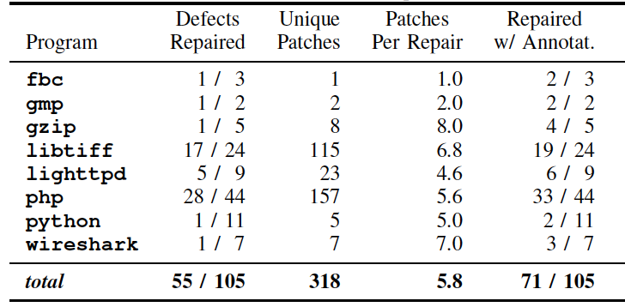
Impact of Alternative Repair Strategies
Multiple Repairs:
Allowing each trial to run to completion produced 318 unique patches from 55 repairs.
On average, 5.8 distinct patches per defect give developers multiple options.
Slight increase in total cost (from $403 to $502).
Human Annotations:
Using programmer-provided hints (fault and fix localization annotations) increased repair success to 68% (71 out of 105 defects).
Annotations also reduced the time to the first repair by about 50%.

Slide 12
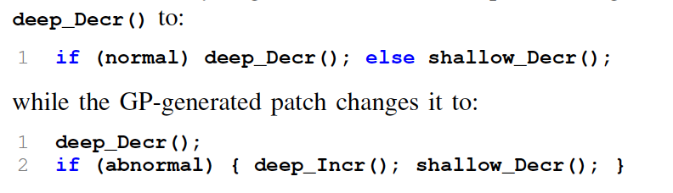
Comparing Automated vs. Human-Written Repairs
Python Date Handling Example:
Human Patch: Removed a global dictionary and extra processing (17 lines plus additional changes).
GenProg Patch: Removed the 17 lines but left the unused dictionary.
Result: Functionally correct; however, the automated patch may be less optimal in memory usage and maintainability.
PHP Global Object Accessor Crash Example:
Human Patch: Replaces a deep decrement with an if-then-else structure.
GenProg Patch: Inserts additional code to check for an abnormal case (changes command ordering).
Result: Both achieve the desired functionality, though the human patch appears more natural.

Slide 13
Limitations
Generalizability Concerns:
Benchmarks are "best effort" and may not represent all real-world settings.
Selection bias is mitigated, but results may not generalize to non-open source or industrial environments.
Scope Limitations:
Evaluated only on deterministic bugs in C code.
Excludes race conditions and multi-language bugs.
Dependency on Test Cases:
Approach relies on checked-in bugs with associated test cases.
Bugs without tests cannot be repaired.
Algorithm Sensitivity:
Results may vary with GP parameters.
Representation choice and genetic operators have a larger impact than tuning parameters

Slide 14
Thank you

